Slide 1
Object-Oriented Programming
WEEK 05 Abeeha Sattar

Slide 2
Types of Relationships:
Has – a / has – an
An object contains one or more objects of other classes as members
Association/Aggregation/Composition fall into this category
Is – a / is – an
A class is an extension of another class
Inheritance falls into this category

Slide 3
Association in OOP
Association is a relationship between two objects.
It defines the multiplicity between objects. Some of the multiplicities are:
one-to-one, 1 1
one-to-many, 1 *
many-to-one, * 1
many-to-many. * *
You can have other numbers as multiplicities as well

Slide 4
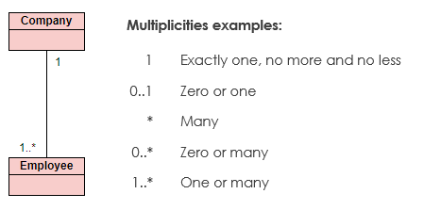
More on Multiplicity

Slide 5
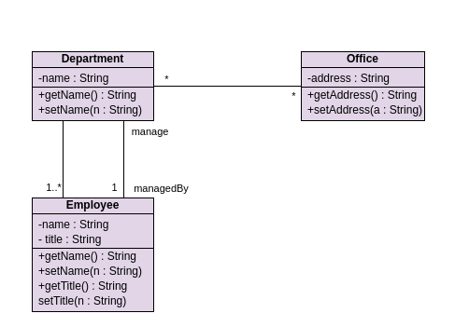
Example of Association

Slide 6

Aggregation
Aggregation is a specialized form of association between two or more objects in which each object has its own life cycle but there exists an ownership as well.
Aggregation is also called a “Has-a” relationship.
Aggregation is usually represented in UML using a line with a hollow diamond towards the class that owns the other object.

Slide 7

Composition
Composition is a special case of aggregation.
In a more specific manner, a restricted aggregation is called composition.
When an object contains the other object, if the contained object cannot exist without the existence of container object, then it is called composition.
Composition is represented in UML using a line connecting the objects with a solid diamond at the end of the object that owns the other object.
Notes:
https://javapapers.com/oops/association-aggregation-composition-abstraction-generalization-realization-dependency/
https://www.infoworld.com/article/3029325/exploring-association-aggregation-and-composition-in-oop.html

Slide 8
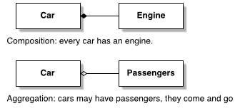







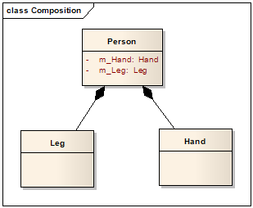
Examples
Note that these are partial class diagrams.
We’ll always be making complete ones!
Window
Scrollbar
1
1
Titlebar
1
1
Menu
1
1 ..

Slide 9
Composition in Code
class Engine{};
class Car {
Engine e;
public:
Car() {} //empty default constructor
};

Slide 10
Aggregation in Code (pt. 1)
class Person {
bool seated = false;
public:
void isSeated() {
if (seated)
cout << "I've been seated!" << endl;
else
cout << "Not seated yet!" << endl;
}
void setSeated(bool s) {
seated = s;
}
};

Slide 11
Aggregation in Code (pt. 2)
class Car {
Engine e;
Person *p;
public:
Car() {
p = nullptr;
}
Car(Person* p) {
this->p = p;
this->p->setSeated(true);
}
Person* getP() {
return p;
}
void setP(Person* p) {
this->p = p;
this->p->setSeated(true);
}
void unloadPassenger() {
p->setSeated(false);
p = nullptr;
}
~Car() {
if (p) {
p->setSeated(false);
p = nullptr;
}
}
};

Slide 12
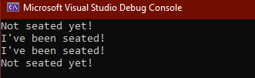
Aggregation in Code (pt. 3)
int main()
{
Person p;
p.isSeated();
Car c(&p);
p.isSeated();
c.setP(&p);
p.isSeated();
c.unloadPassenger();
p.isSeated();
return 0;
}

Slide 13
Mid Term – I Discussion

Slide 14
Fin.
: 3

